Slide 1
Library System
A project implemented for MPP Course
Huthaifa Anqawi
Mosheer Ahmad
Mauro Nogueira

Slide 2
Agenda
Scope statement
Planning
Class Diagram
System Features
Sequence Diagrams
System Demo

Slide 3




Planning
Planning
Requirements Elicitation
Design
Coding
Presentation
Kickoff
Nov-30
Presentation
Dec-4th

Slide 4
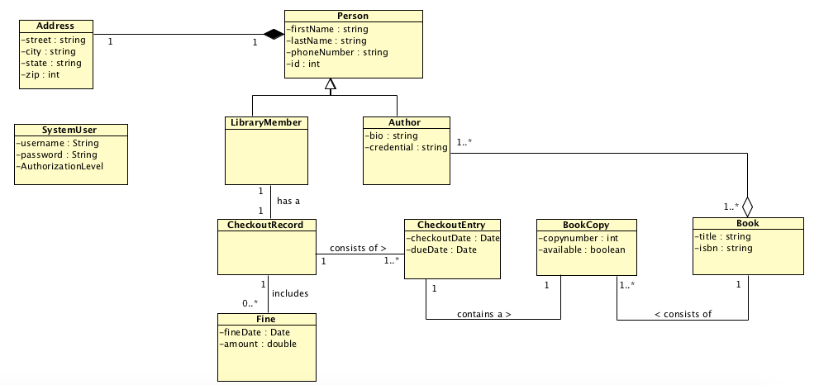
Class Diagram

Slide 5
System Features
Login screen
Main Panel
System options according privilege access
Checkout a book
Add a member
Add a book
Add book copy
View checkout records

Slide 6
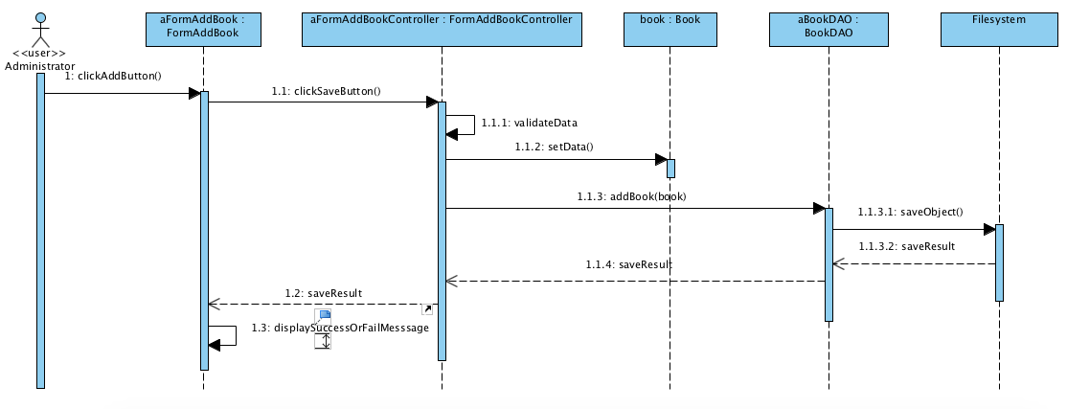
Sequence Diagram
(addBook)

Slide 7
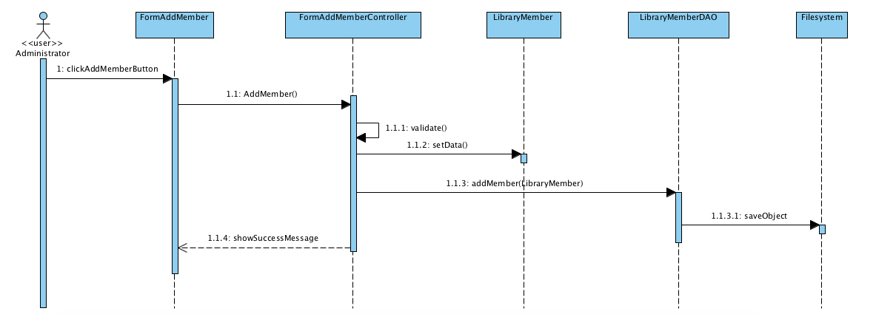
Sequence Diagram
(addLibraryMember)

Slide 8
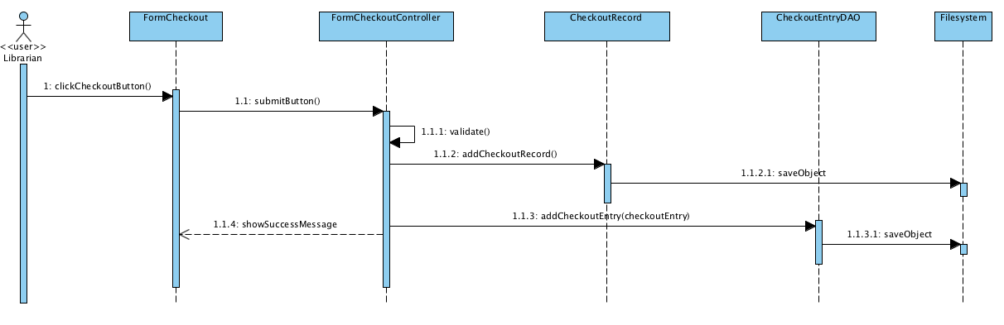
Sequence Diagram
(checkoutBook)

Slide 9
System Demo

Slide 10
Questions?

